Slide 1






Performance & Quality Improvement (PQI) Report
Data for week ended Sunday, December 10, 2023
Mission
Improving safety, permanency and well-being for all children in Polk, Highlands, and Hardee Counties
Vision
To eliminate child abuse and neglect in
Polk, Highlands, and Hardee Counties

Slide 2
Community Based Care Lead Agency Scorecard
FY 23-24, Quarter 1 Performance

Slide 3
Scorecard Measure 4 – Children Seen Every Thirty Days
SM04 - Percent of children under supervision who are required to be seen every 30 days – Target = 99.5%
Current Month
Prior
Month End

Slide 4
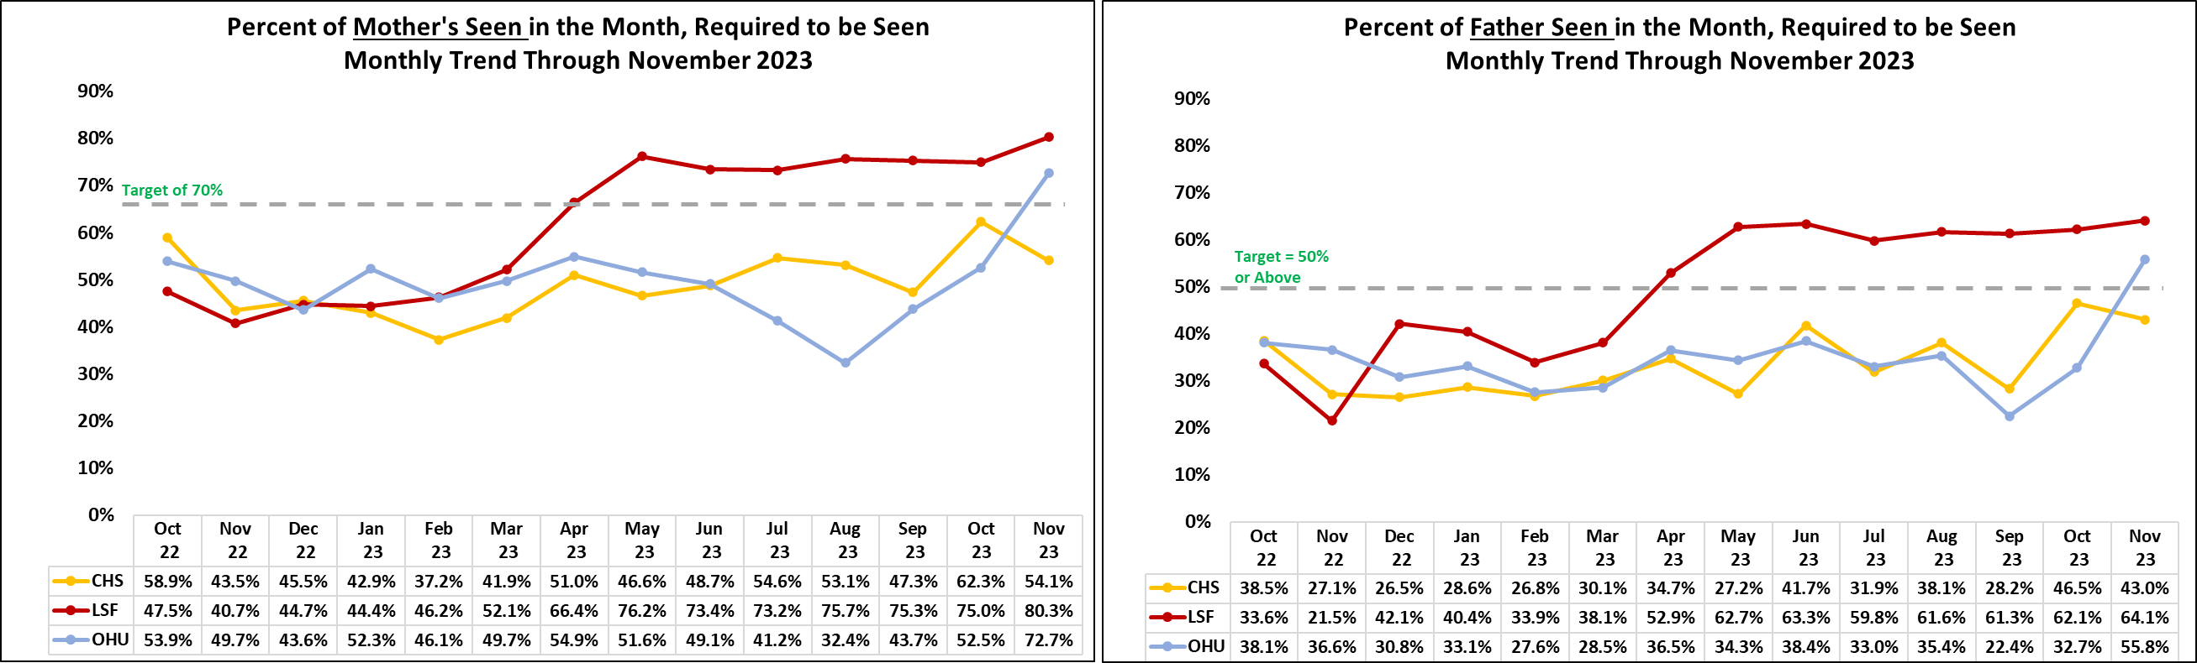
Monthly Birth Parent Contacts
Target = 70% Mothers and 50% Fathers - seen monthly
Current Month
Mother Contact, Target is 70% or above
Father Contact, Target is 50% or above

Slide 5
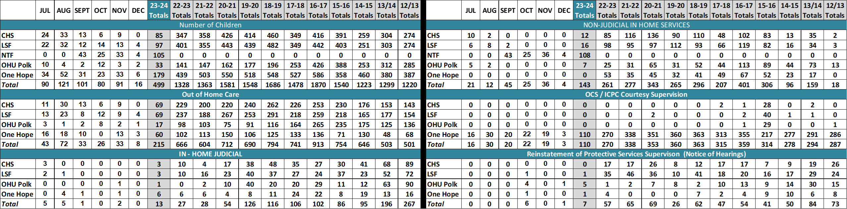
Case Transfer Staffing Data
Case Transfer Data For Fiscal Year 2023/24 - Data as of 12/11/2023

Slide 6
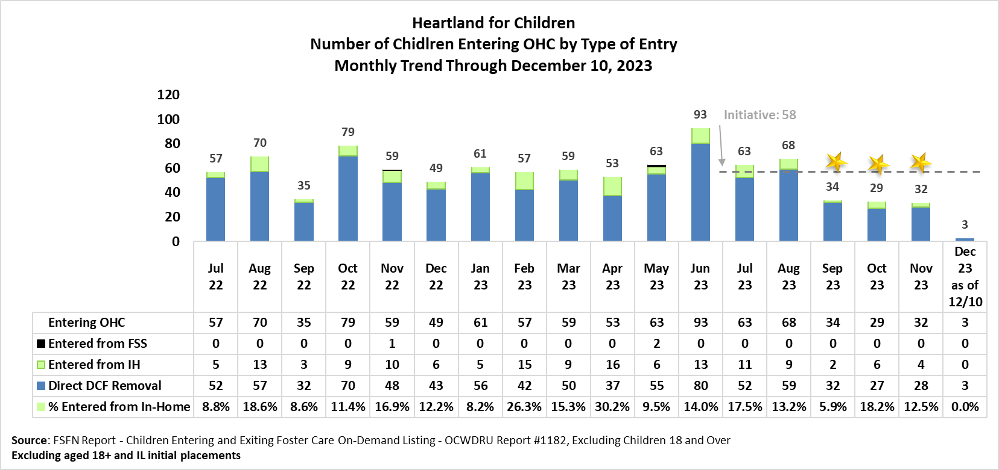
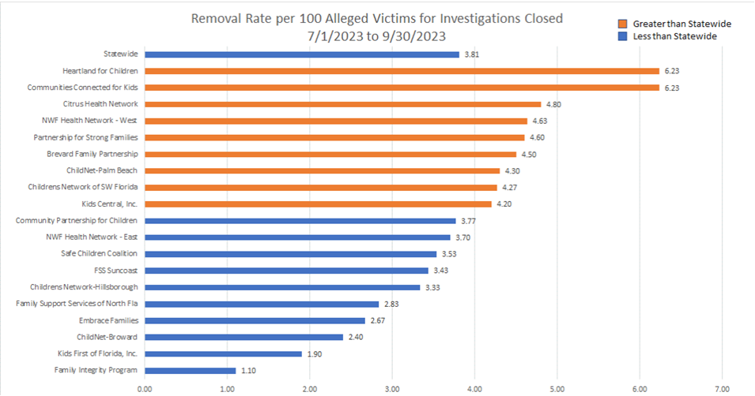
Children Entering Out of Home Care
Source: Fiscal Year 23/24 Q1 DCF Key Indicator Report

Slide 7
Children Re-Entering Out-of-Home Care
Number of Children in a Recent Removal Episode Who Have Had a Prior Reunification or Permanent Guardianship
Re-Entry into OHC
Last 2 Weeks
No new re-entry into OHC entered into FSFN in the last 2 weeks
Source: FSFN Data Warehouse Ad Hoc Report,
Scorecard Measures 7 – Children Who Do Not Re-Enter into OHC after Achieving Permanency
SM07 - Percent of children exiting care to a permanent home within 12 months of entering care – Target = 91.7% or Greater
FY 23/24
Contract Measure
Source: Children Who Do Not Re-Enter Foster Care within Twelve (12) Months of Moving to a Permanent Home On-Demand Listing - OCWDRU Report #1100

Slide 8
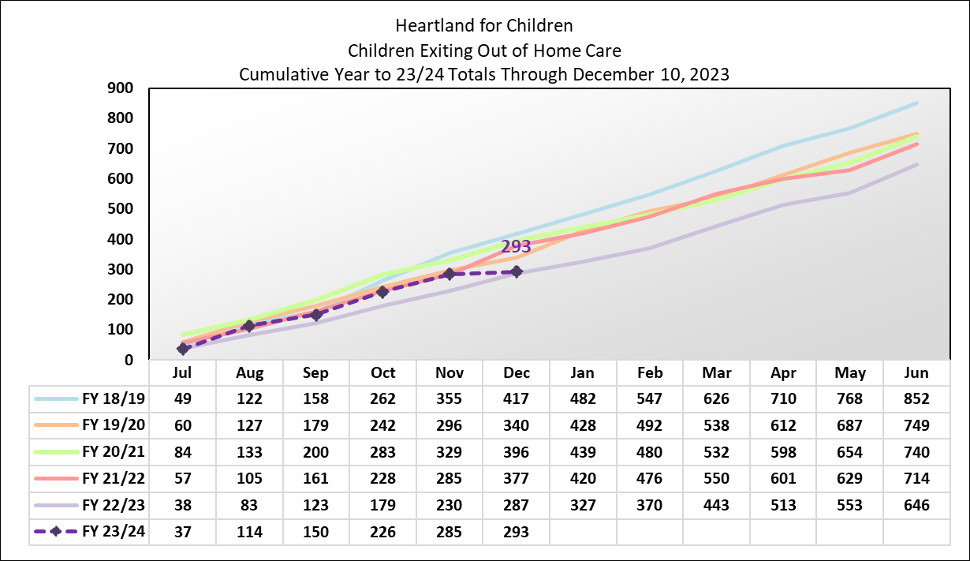
FY 2023-2024 Exiting Out-of-Home Care Initiative

Slide 9
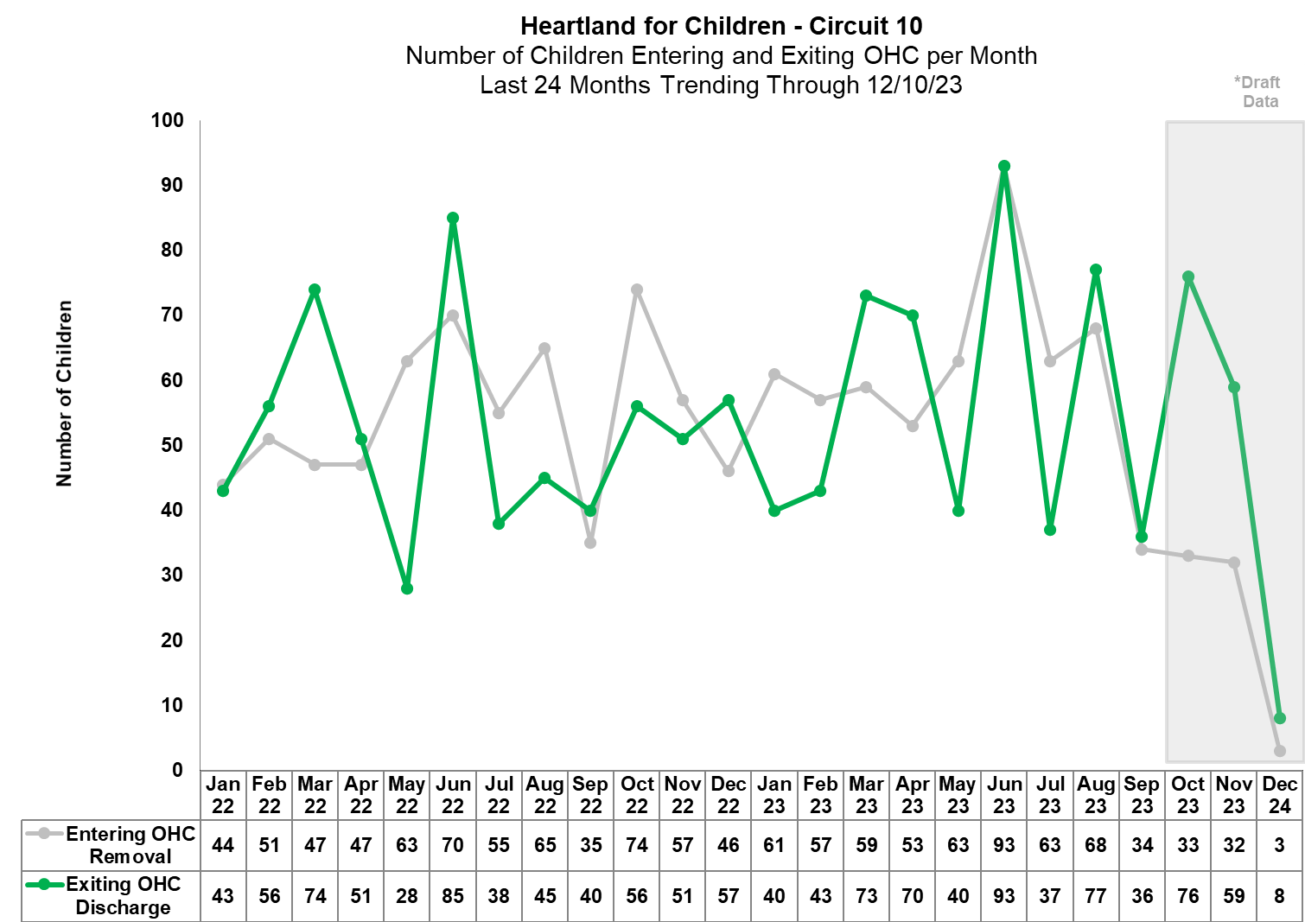
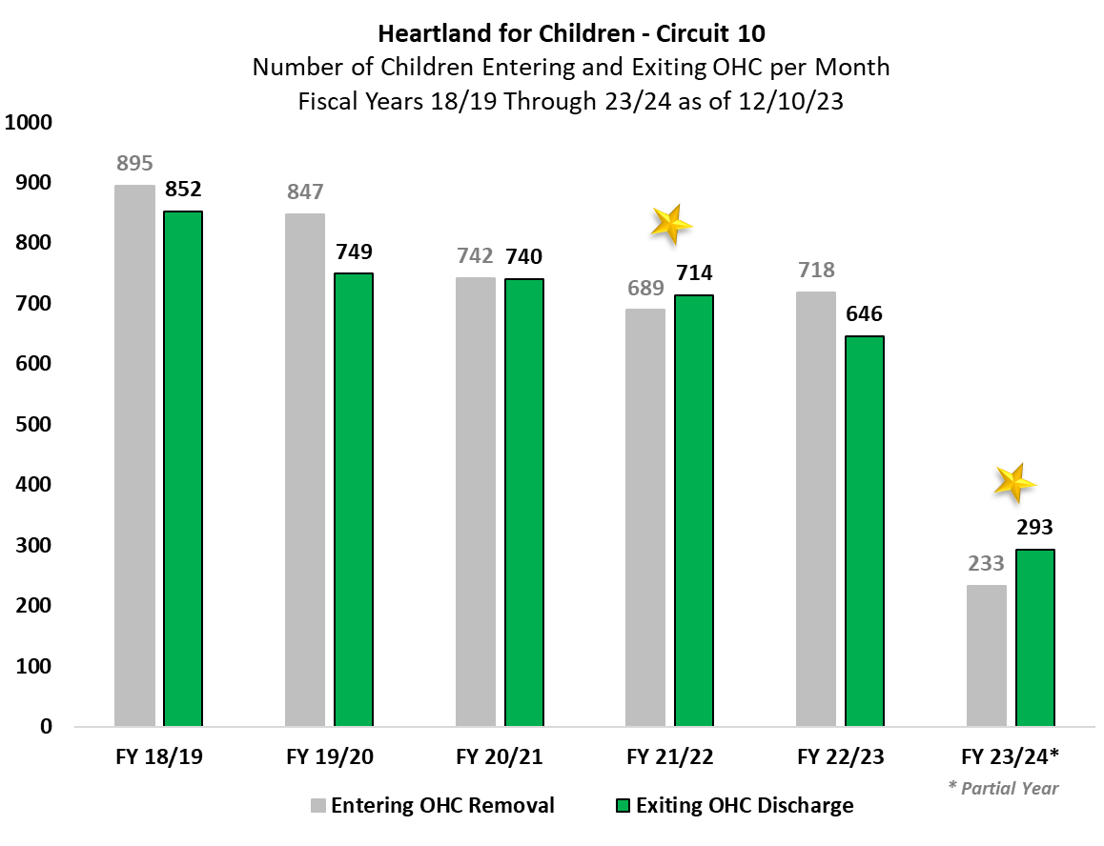
FY 2023-2024 Entering and Exiting Out-of-Home Care – Exit Initiative

Slide 10
Scorecard Measures 5 - Children Achieving Permanency within 12 Months (Fiscal Year 23/24)
Target = 40.5%
Percentage to reach Yellow = 36.5%
By Unit
Source: Children Exiting Out-of-Home Care to a Permanent Home within Twelve Months of Entering Care On-Demand Listing - Report #1119
Reporting Period: July 1, 2022, to June 30, 2023

Slide 11
Permanency Measure for Children in Out-of-Home Care...
- More than 12 Months in OHC
- More than 24 Months in OHC
Scorecard Measures 6: Percent of children exiting care to a permanent home for children in care 12-23 months,
Target = 43.6%
Statewide Measure: Percent of children exiting care to a permanent home for children in are 24 months or longer
Target = 30%
SM06 - Percentage to reach Yellow = 39.4%
Source: Children Achieving Permanency w/ 12 Months for children in OHC 12-23 Months On-Demand Listing - Report #1138
Source: Children Achieving Permanency w/ 12 Months for children in OHC 24 Months or Longer On-Demand Listing - Report #1197

Slide 12
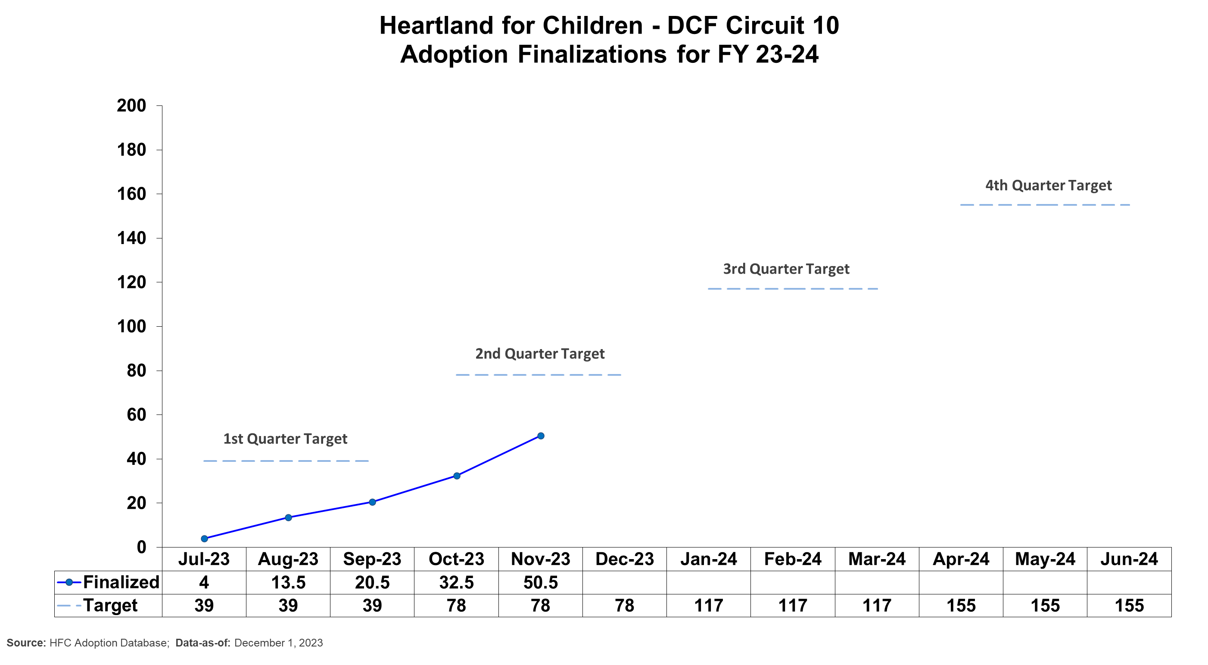
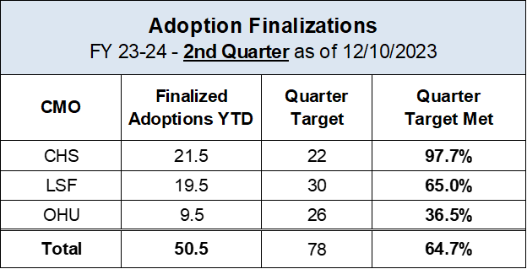
Adoption Finalizations
Percent of Adoptions Finalized with 24 Months of Removal & Percent of Adoption Goal Met
Upcoming Finalization Dates
- December 13, 2023
- January 3 & 24, 2024

Slide 13
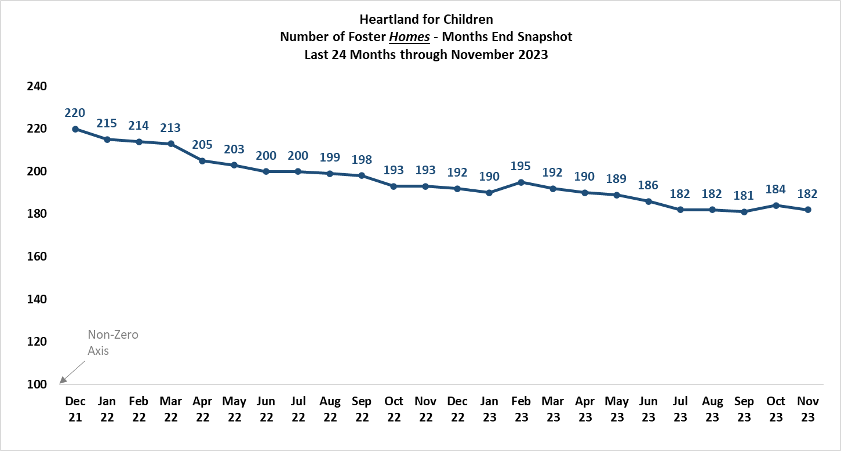
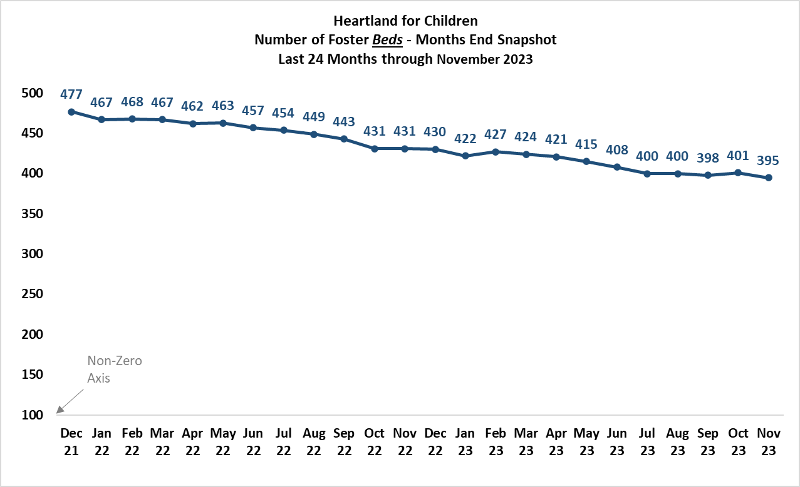
Number of Foster Homes and Foster Bed Capacity
24 Month Trend

Slide 14
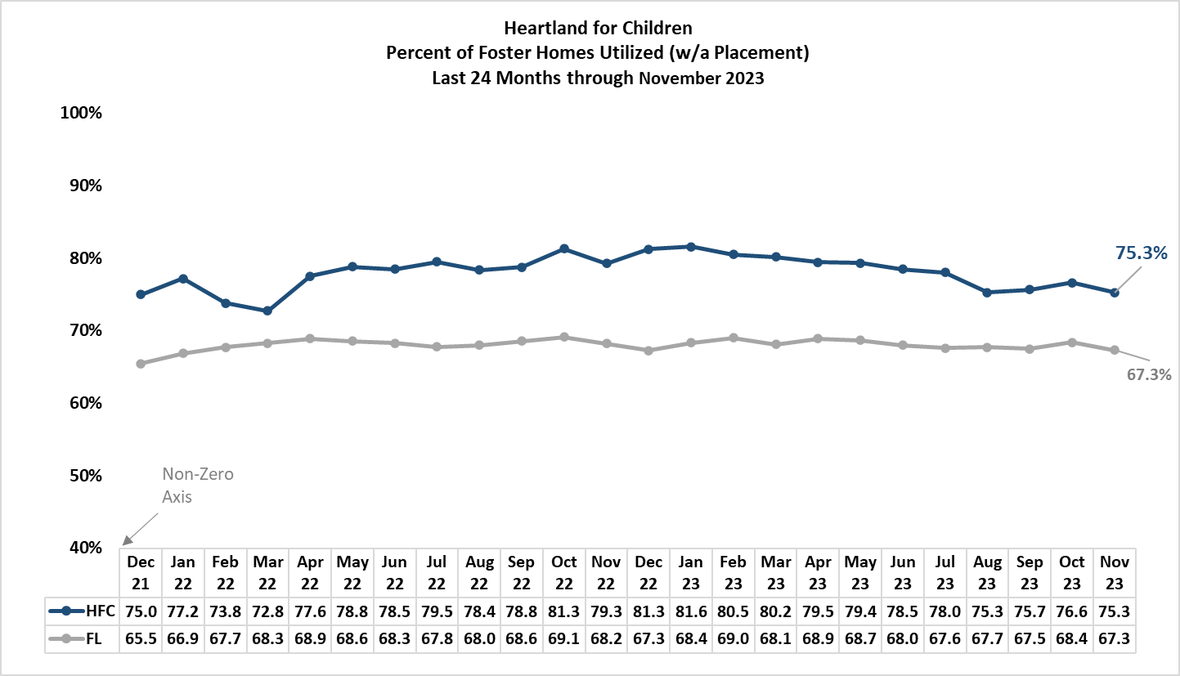
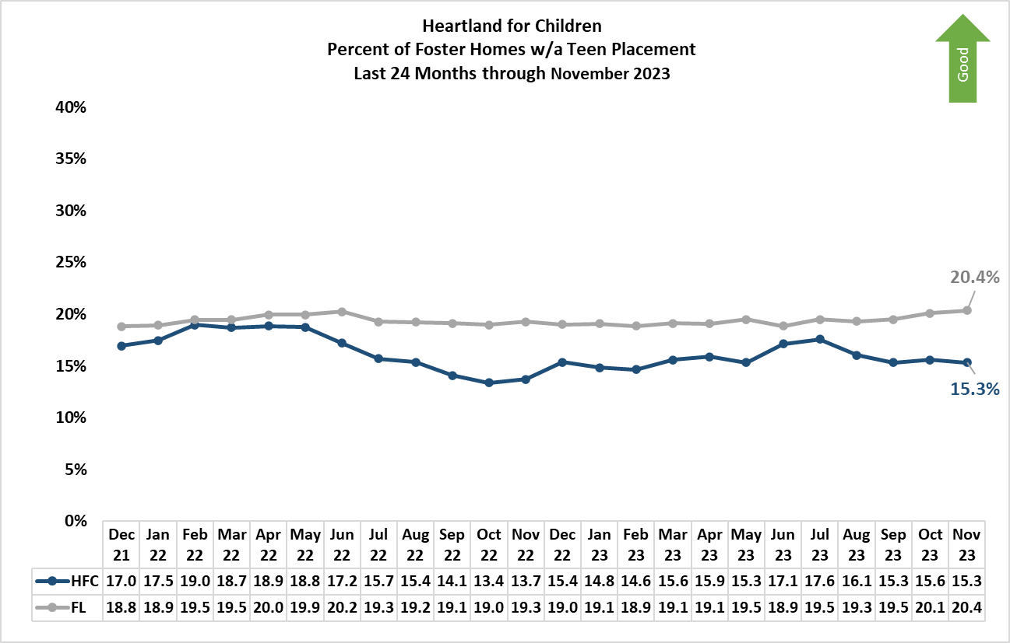
Percent of Foster Home Utilization
Teen Placement in a Foster Home

Slide 15
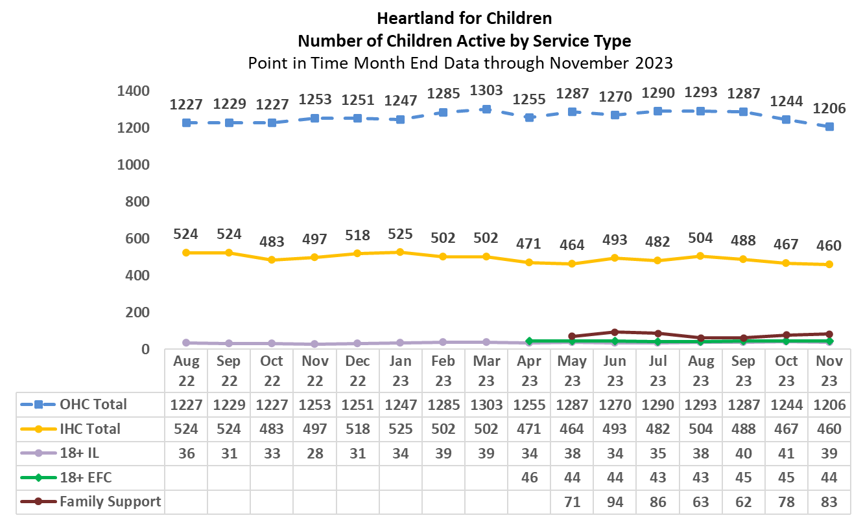
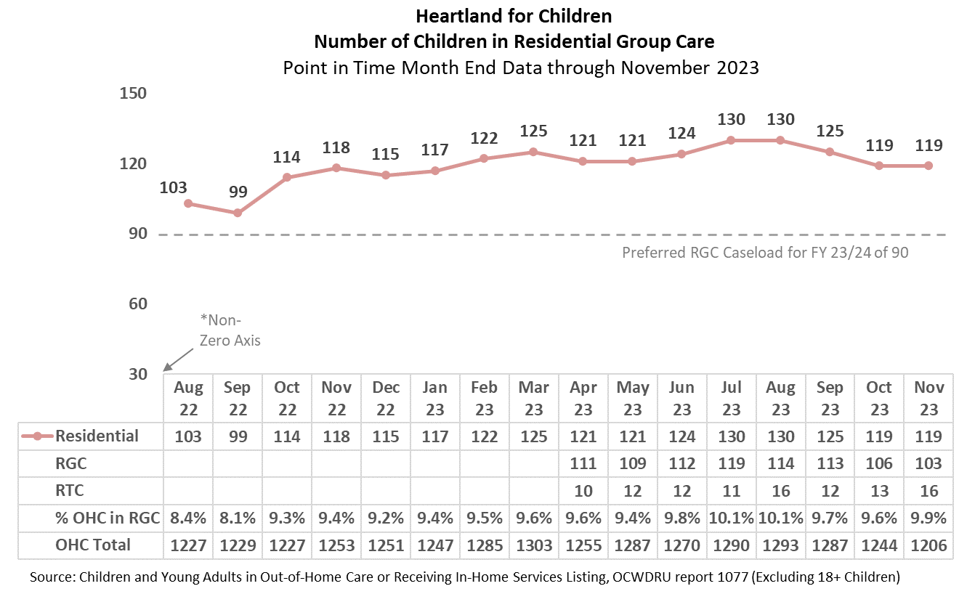
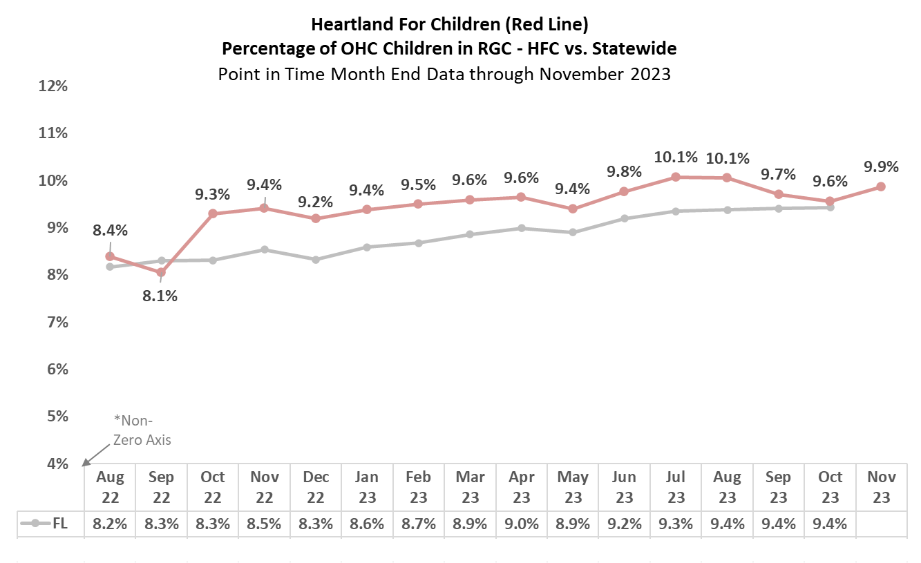
Children Served at Month End by Service Type
Number and Percent of Children Serviced in Residential Care
OHC - Out of Home Care ● RGC - Residential Group Care ● RTC - Residential Treatment Center
IHC - In Home Care ● IL - Independent Living ● EFC - Extended Foster Care

Slide 16
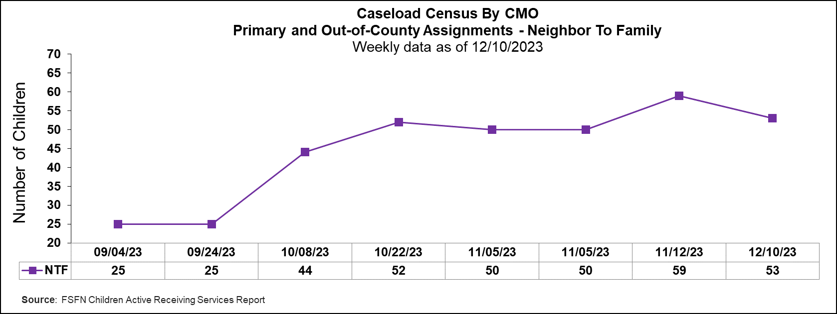
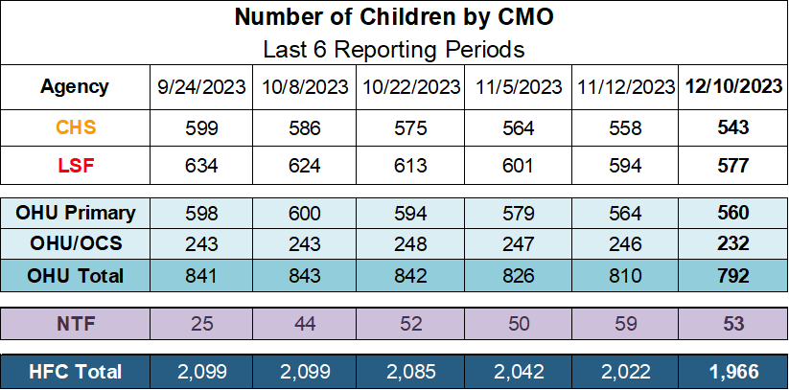
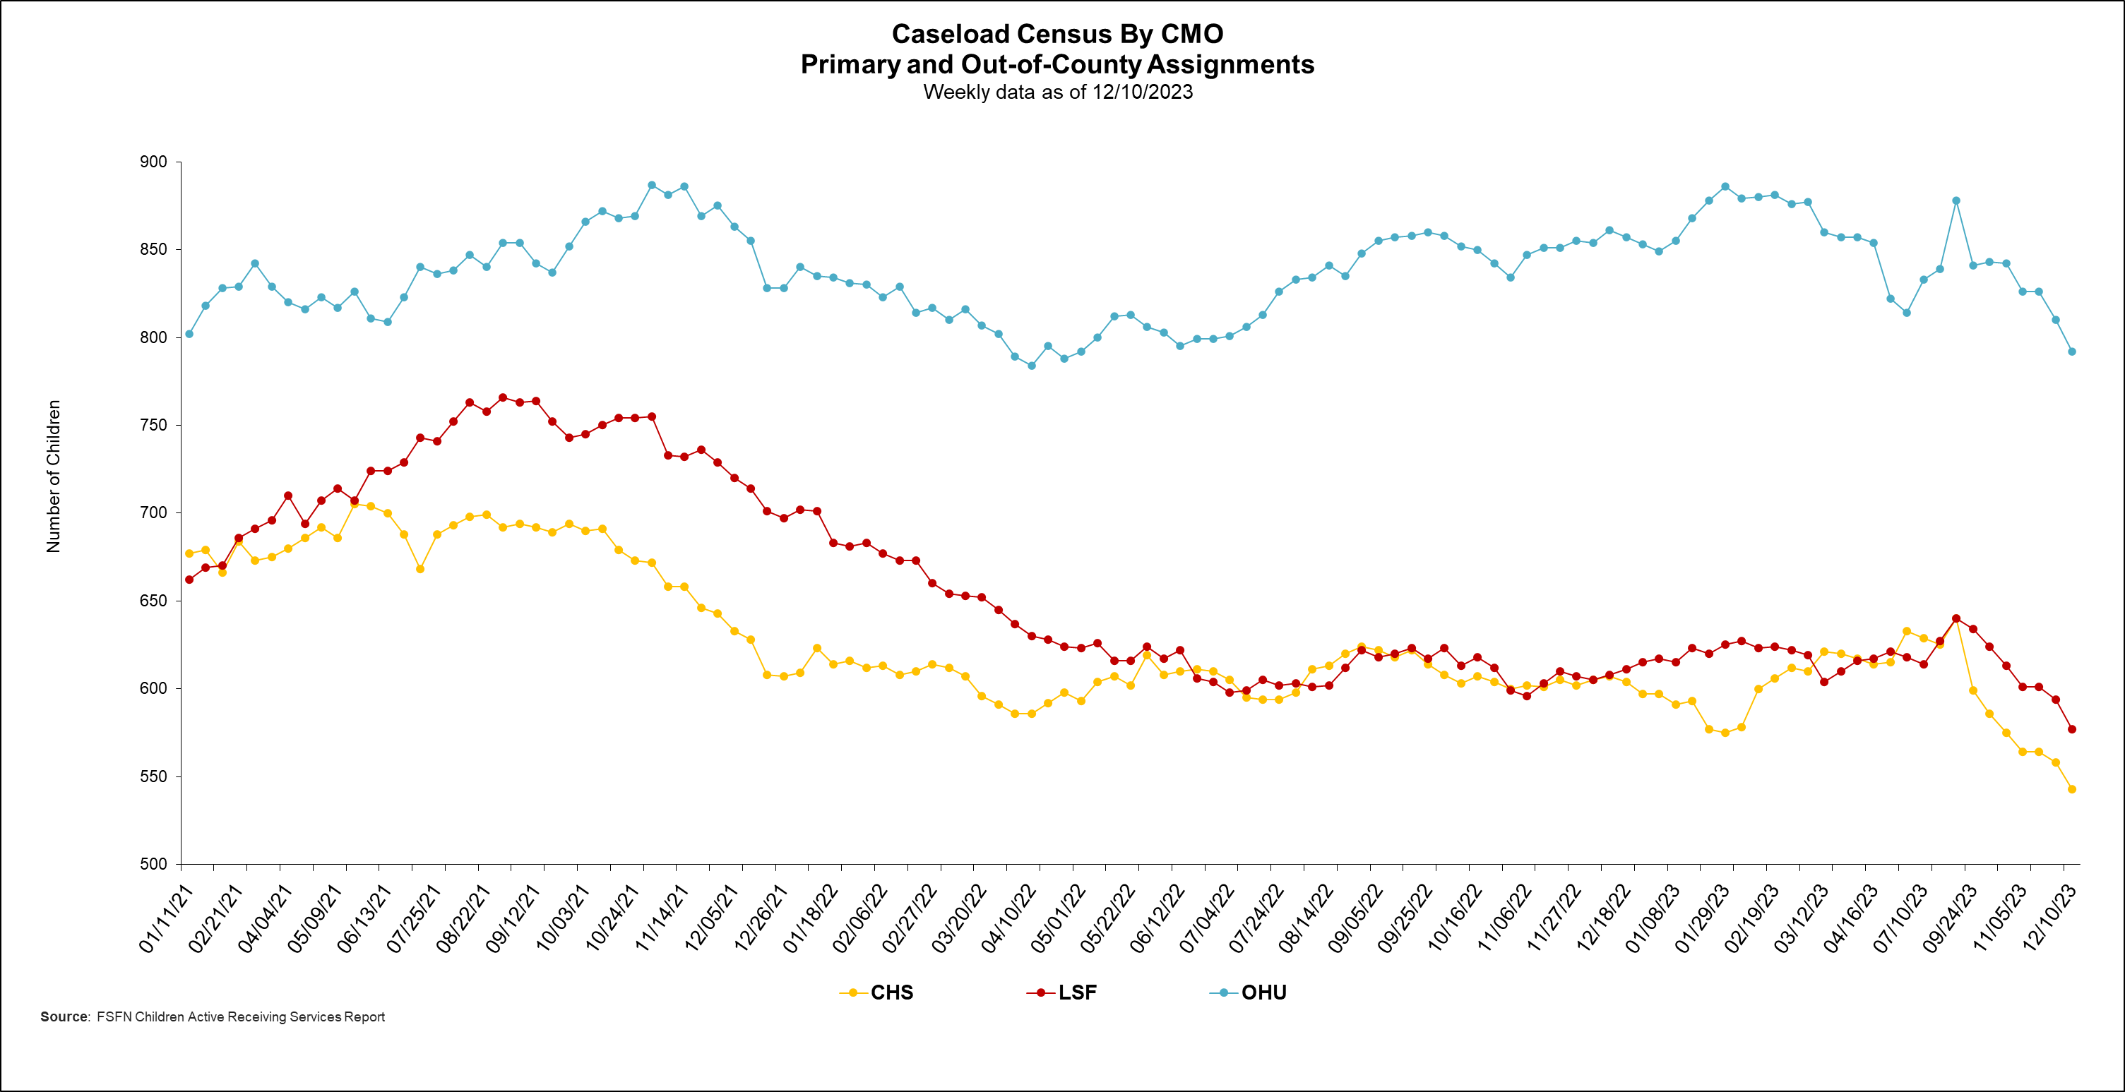
Caseload Census Information
CBC Services Weekly Caseloads By CMO

Slide 17
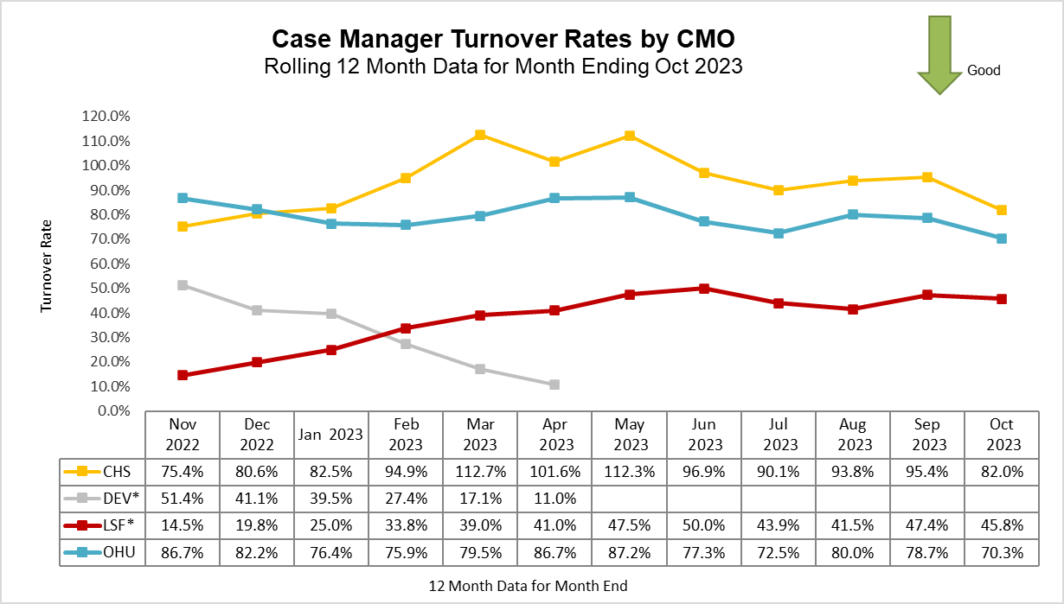
Caseload Census Information
Case Manager Caseload Breakdown by Agency – Data as of 12/10/23
* Data Excludes Unit Supervisors, FTC Facilitators & Resigned CMs Count
Case Management Organization Turnover
12 Month Case Manager Turnover Rates by Agency
7/2/22 - Transition from Devereux to Lutheran Services Florida; the 12-months required for a “Rolling Year Total” has been split between agencies:
DEV: Mar-22 to Jun-22 (4 months)
LSF: Jul-22 to Feb-23 (8 months)

Slide 18
Caseload Census by Case Manager and Organization
Data as of 12/10/2023
*These OHU case managers contain caseloads that are over 65% OCS cases. On average an OCS case compares to 1.54 regular cases (i.e., 20 OCS cases approx. equals 13 regular cases).
All CHS case managers are supported by Case-Aim support. On average a Case-Aim supported case compares to 1.33 regular cases (i.e., 20 cases with Case-Aim approx. equals 15 cases without Case-Aim support).
Red = Supervisors, FTC Facilitators & Resigned CMs carrying cases Orange = Terminated Workers Carrying Caseloads in FSFN

Slide 19
Healthcare Information
Data Entered Into FSFN for Children in Out-of-Home Care
Scorecard Measures 9 & 10 - Children Receiving Healthcare Services
SM 9 - Percent of children in out-of-home care who have received medical services in the last 12 months – Target = 95%
SM 10 - Percent of children in out-of-home care who have received dental services in the last 7 months – Target = 95%

Slide 20
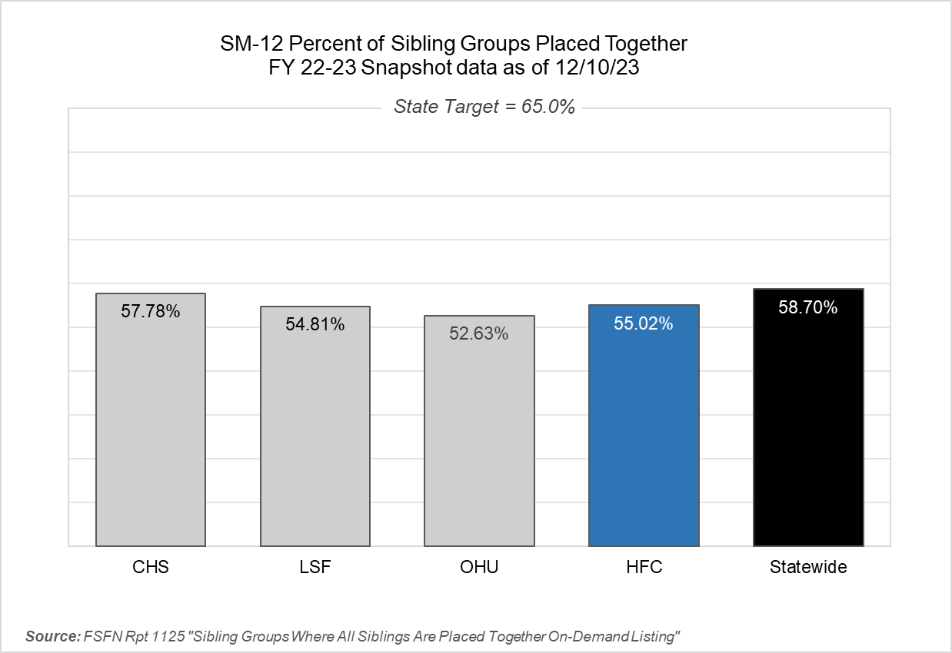
Scorecard Measure 12 – Separated Siblings
SM12 - Percentage of sibling groups in out-of-home care where all siblings are placed together – Target = 65.0%
Number of sibling groups to achieve SM12 target – 28 Sibling Groups

Slide 21
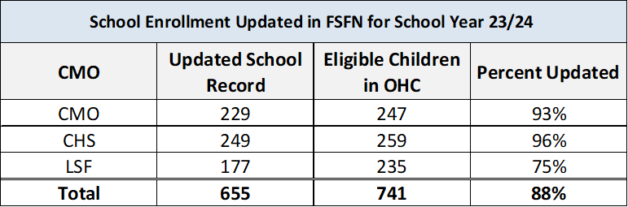
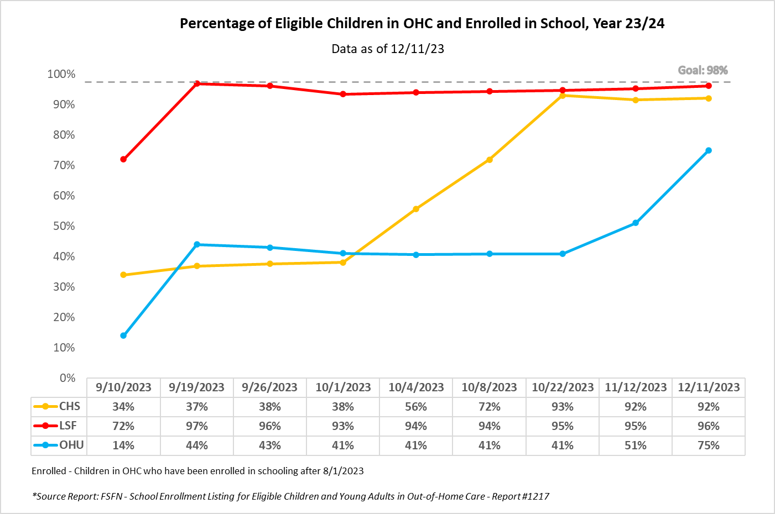
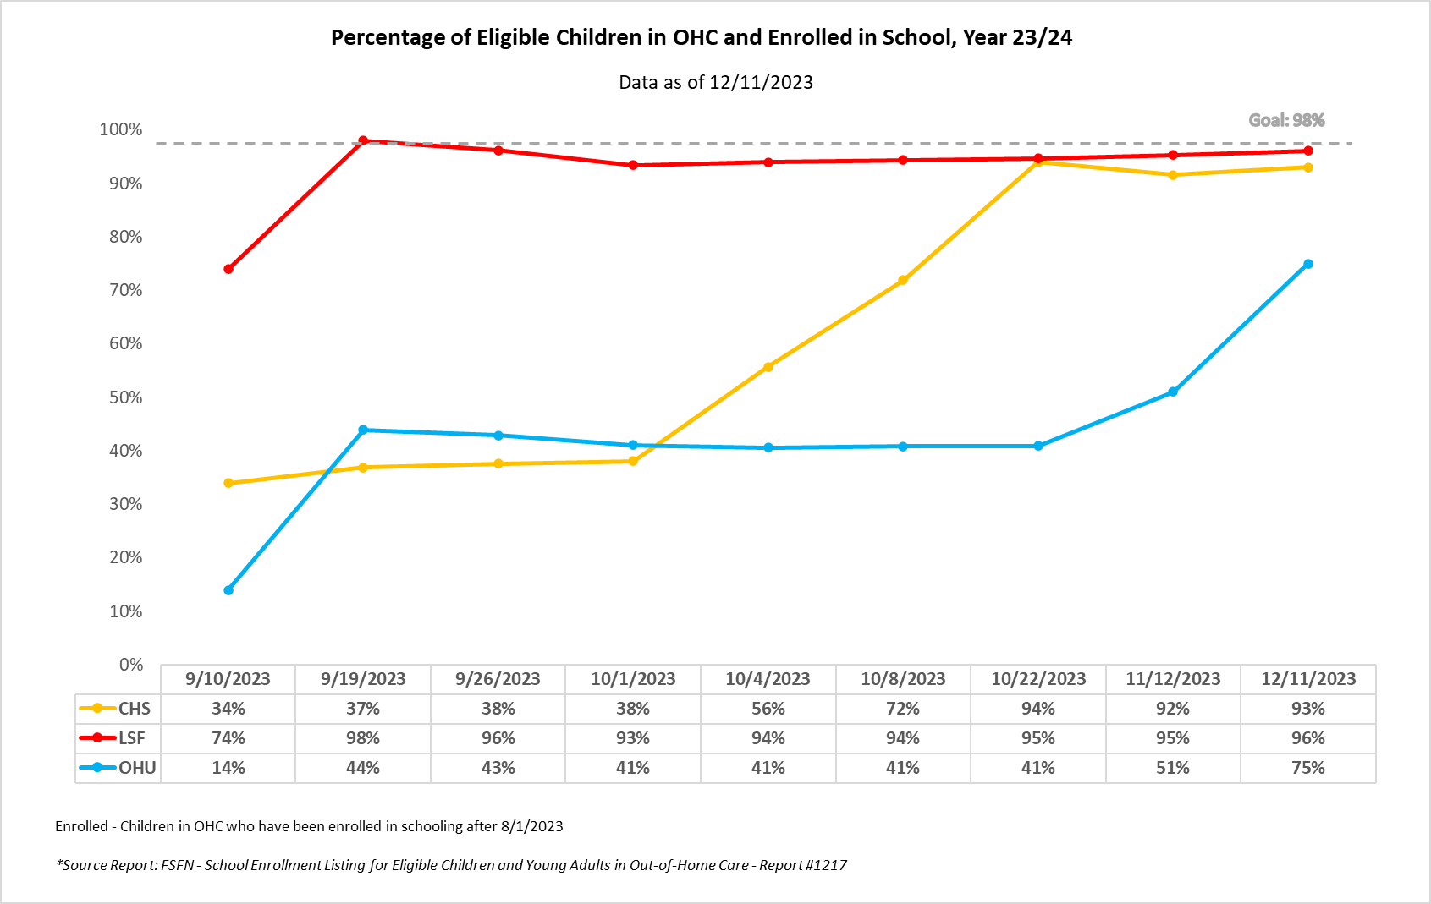
Yearly Project
School Enrollment for Children in Out-of-Home Care

Slide 22
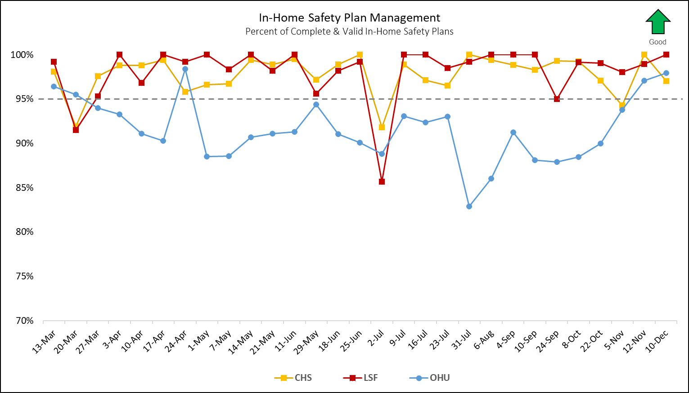
In-Home Safety Plan Management
Percent of Completed In-Home Safety Plans under 180 Effective Days – Target: 95.0%
Source: FSFN Report 1301 “Case Management Safety Management Listing”

Slide 23
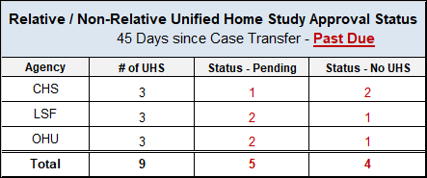
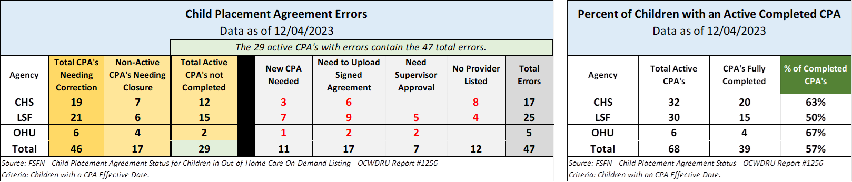
Unified Home Studies – Approval Status
Cases with a Pending or No UHS – 45+ Days Past Due; Data-as-of: 12/10/2023
Child Placement Agreement Errors
Active CPA’s with errors and non-active CPA’s needing closure. Prior update: 08/04/23

Slide 24
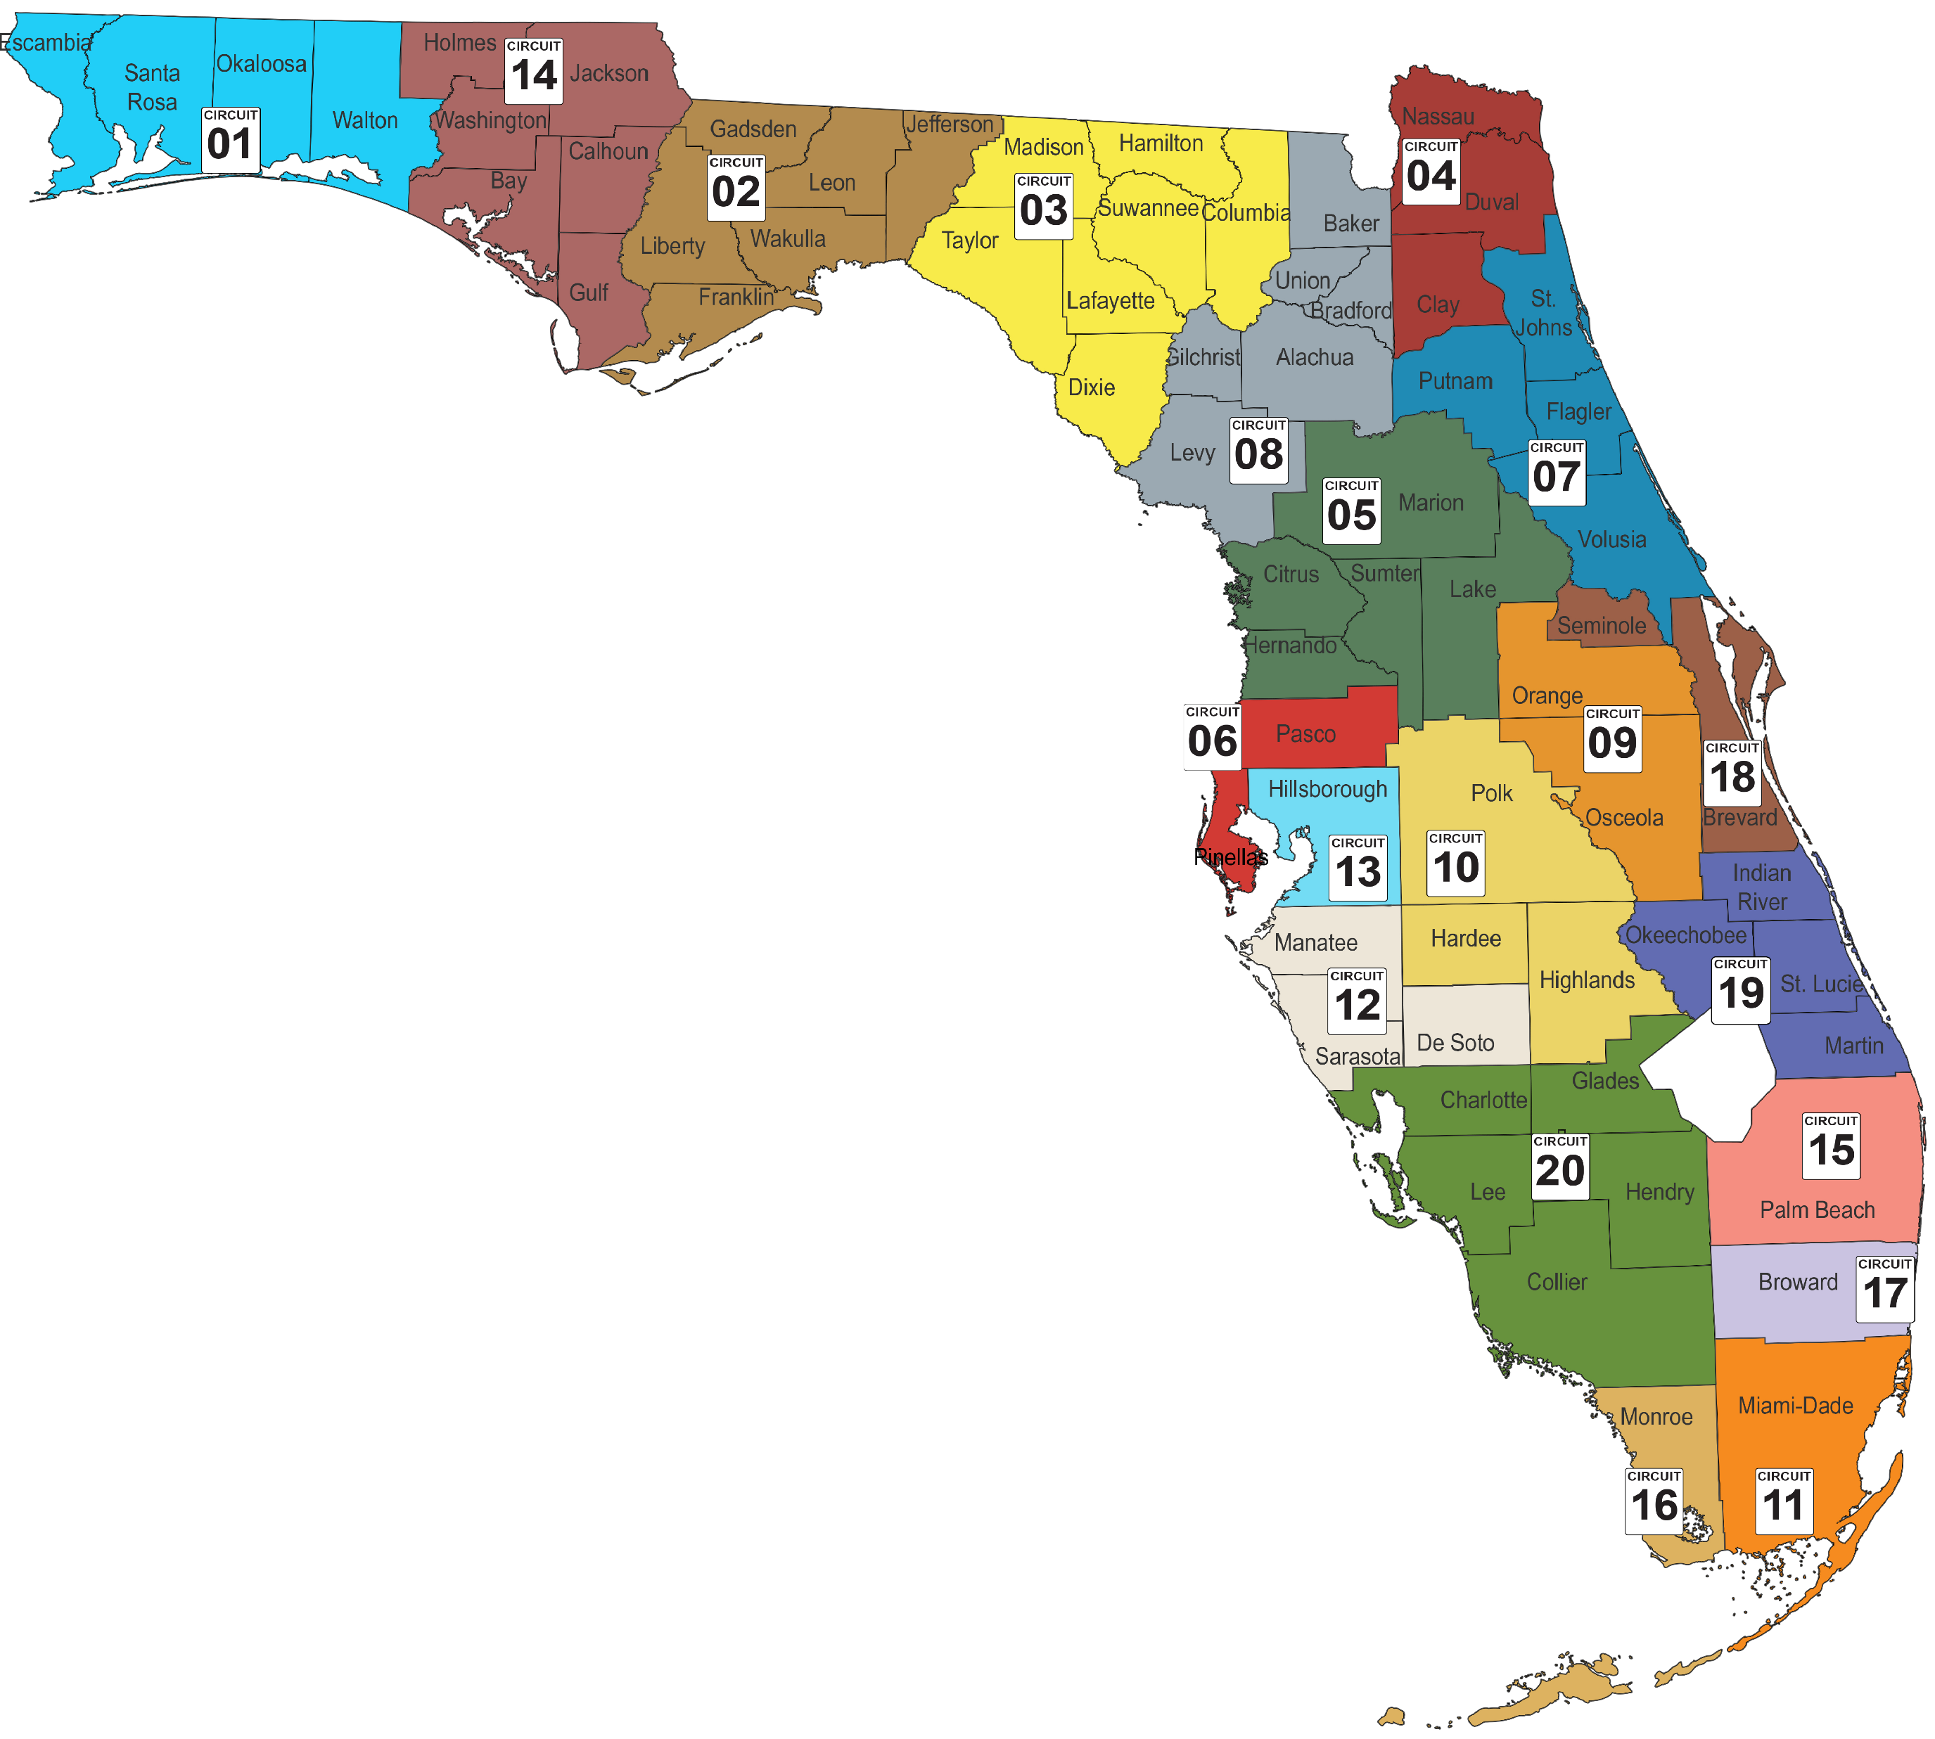
Community Based Care Lead Agency Map
LEGEND
Circuit |  | Region | Counties | Lead Agency
 | 1 | North West | Escambia, Okaloosa, Santa Rosa, Walton | Families First Network
 | 2 |  | Franklin, Gadsden, Jefferson, Leon, Liberty, Wakulla | Northwest Florida Health Network
 | 14 |  | Bay, Calhoun, Gulf, Holmes, Jackson, Washington | Northwest Florida Health Network
 | 3 | North East | Columbia, Dixie, Hamilton, Lafayette, Madison, Suwannee, Taylor | Partnership for Strong Families
 | 4 |  | Clay | Kids First of Florida, Inc.
 | 4 |  | Duval, Nassau | Family Support Services of North Florida, Inc.
 | 7 |  | St. Johns | St. Johns County Board of Commissioners
 | 7 |  | Flagler, Putnam, Volusia | Community Partnership for Children, Inc.
 | 8 |  | Alachua, Baker, Bradford, Gilchrist, Levy, Union | Partnership for Strong Families
 | 5 | Central | Citrus, Hernando, Lake, Marion, Sumter | Kids Central, Inc.
 | 9 |  | Orange, Osceola | Embrace Families
 | 10 |  | Hardee, Highlands, Polk | Heartland For Children
 | 18 |  | Seminole | Embrace Families
 | 18 |  | Brevard | Brevard Family Partnerships
 | 6 | Sun Coast | Pasco, Pinellas | Family Support Services of SunCoast
 | 12 |  | DeSoto, Manatee, Sarasota | Safe Children Coalition
 | 13 |  | Hillsborough | Children's Network of Hillsborough
 | 20 |  | Charlotte, Collier, Glades, Hendry, Lee | Children's Network of Southwest Florida
 | 15 | South East | Palm Beach | ChildNet, Inc.
 | 17 |  | Broward | ChildNet, Inc.
 | 19 |  | Indian River, Martin, Okeechobee, St. Lucie | Communities Connected for Kids
 | 11 | Southern | Miami-Dade | Citrus Family Care Network
 | 16 |  | Monroe | Citrus Family Care Network

